Slide 1

COLLEGE PROJECT
“BUILDING A RESTAURANT WEBSITE”

Slide 2

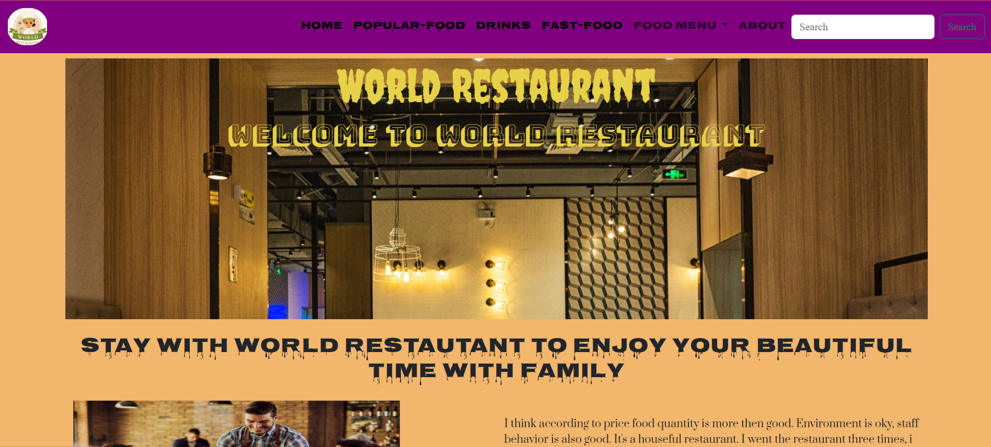
THIS IS OUR WEBSITE’S HOME PAGE

Slide 3

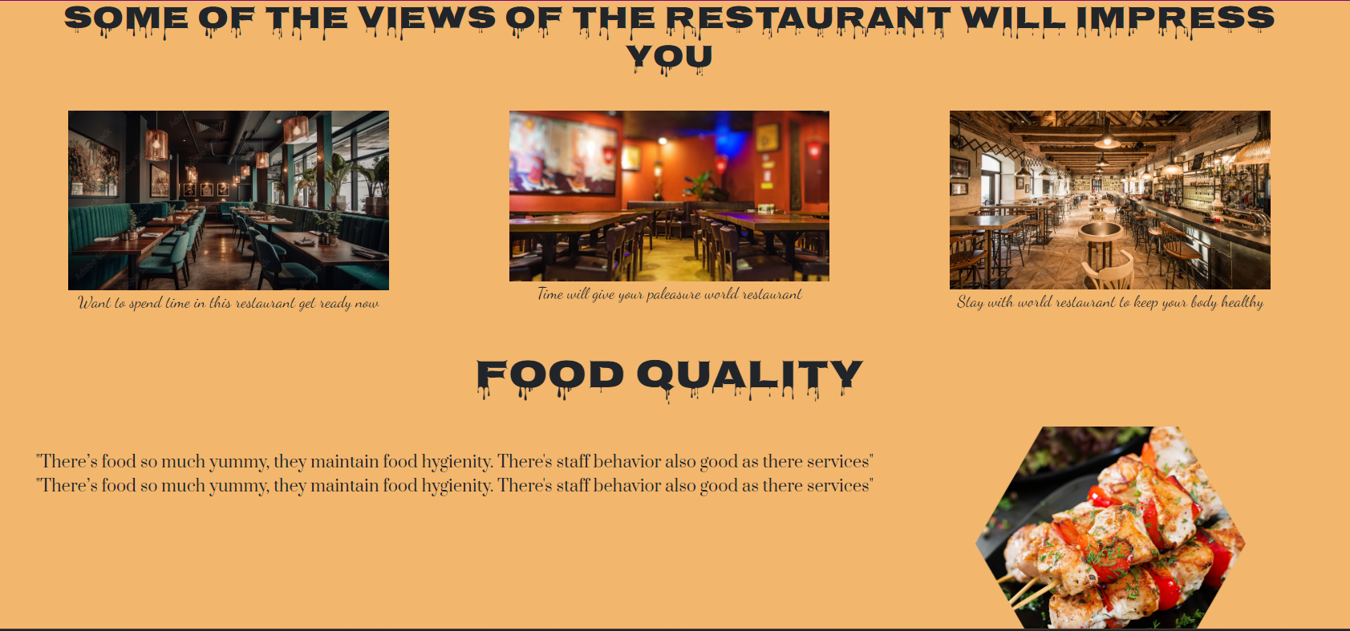
In homepage after header section ,we tried to give some view of restaurant and tried to describe about food quality.

Slide 4

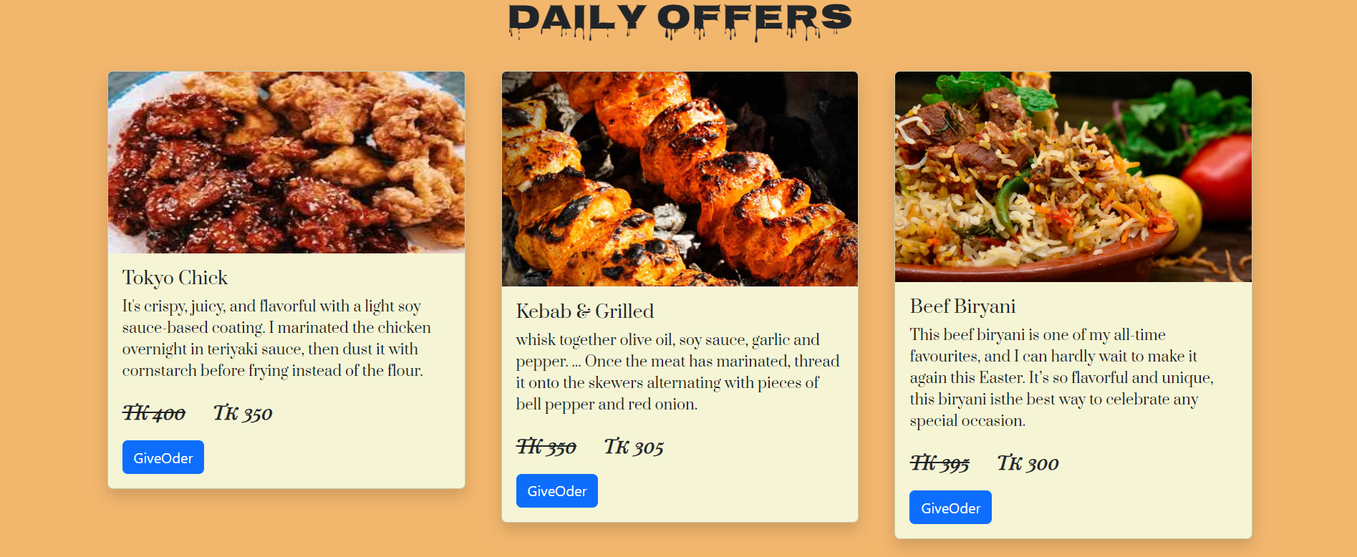
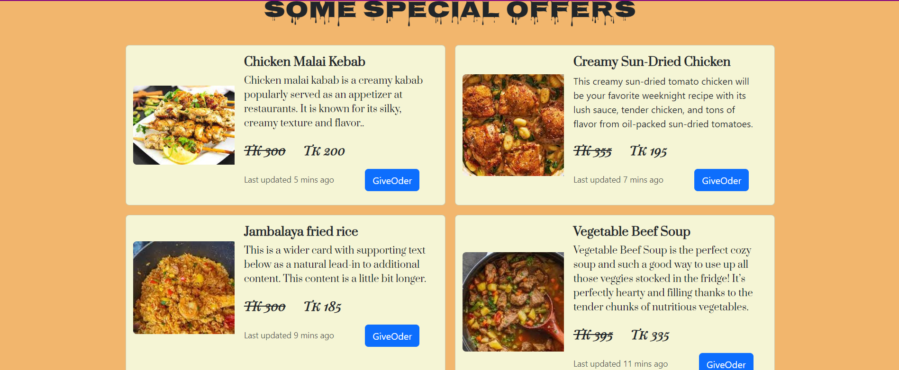
We represents our “DAILY OFFERS” like this in website
We represents our “SPECIAL OFFER” like this in website

Slide 5

AFTER KNOWING WEBSITE STRUCTURE,LET’S START EXPLORING OUR WEBSITE’S NAVBAR ,THEN WE WILL END WITH WEBSITE’S PROGRAM CODE.

Slide 6

NAVBAR INTRODUCTION
1.HOME
2.POPULER-FOOD
3.DRINKS
4.FAST-FOOD
5.FOOD MENU
6.ABOUT

Slide 7

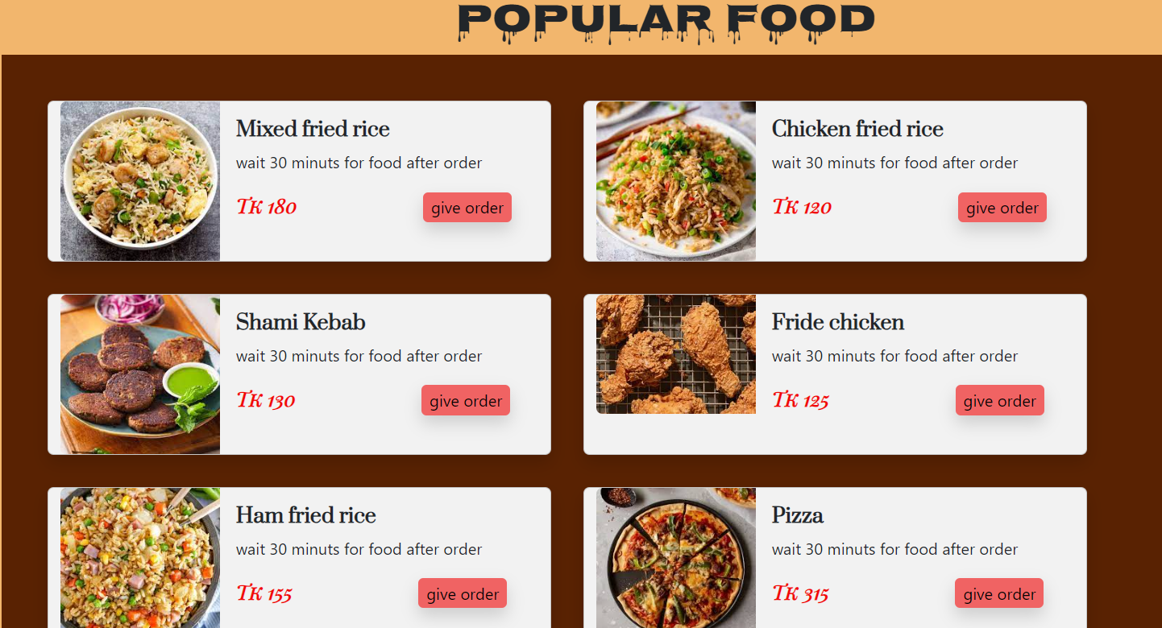
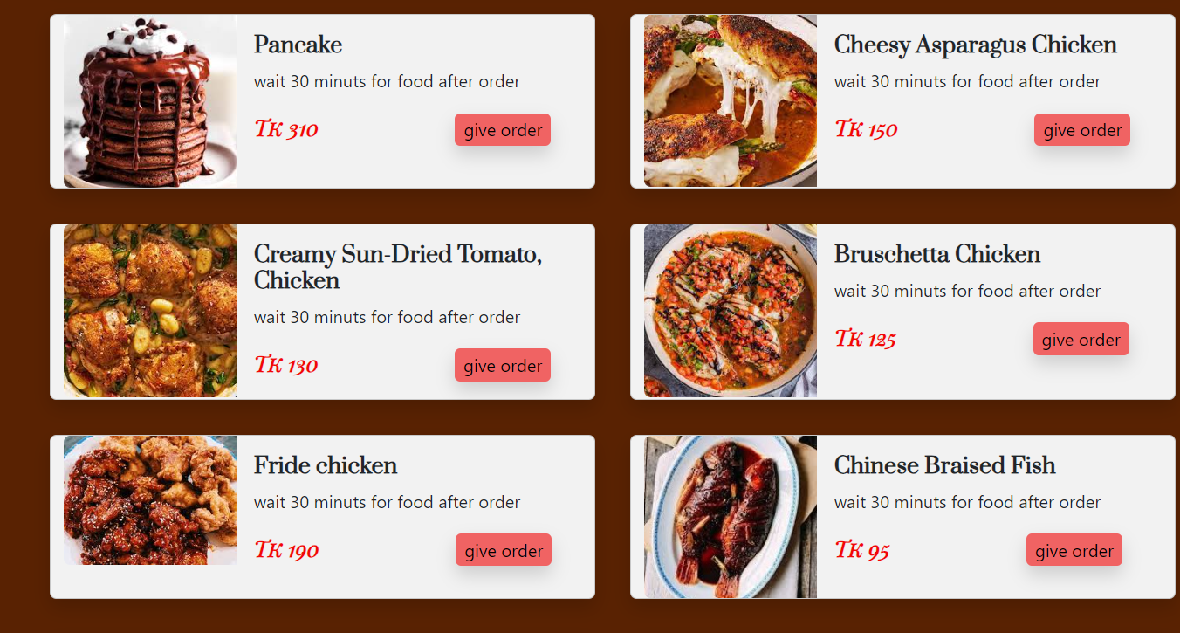
Let’s Explore Popular Food
POPULAR FOOD
THIS ARE ALLTIME FAVOURITE FOOD ITEMS FROM OUR RESTAURANT INCLUDING CUSTOMER FEEDBACK

Slide 8

Let’s Explore Drinks Section
DRINKS
WE SERVE TWO CATEGORIES OF DRINKS.
Obey Your Thirst
SOFT DRINK
ALCOHOL

Slide 9

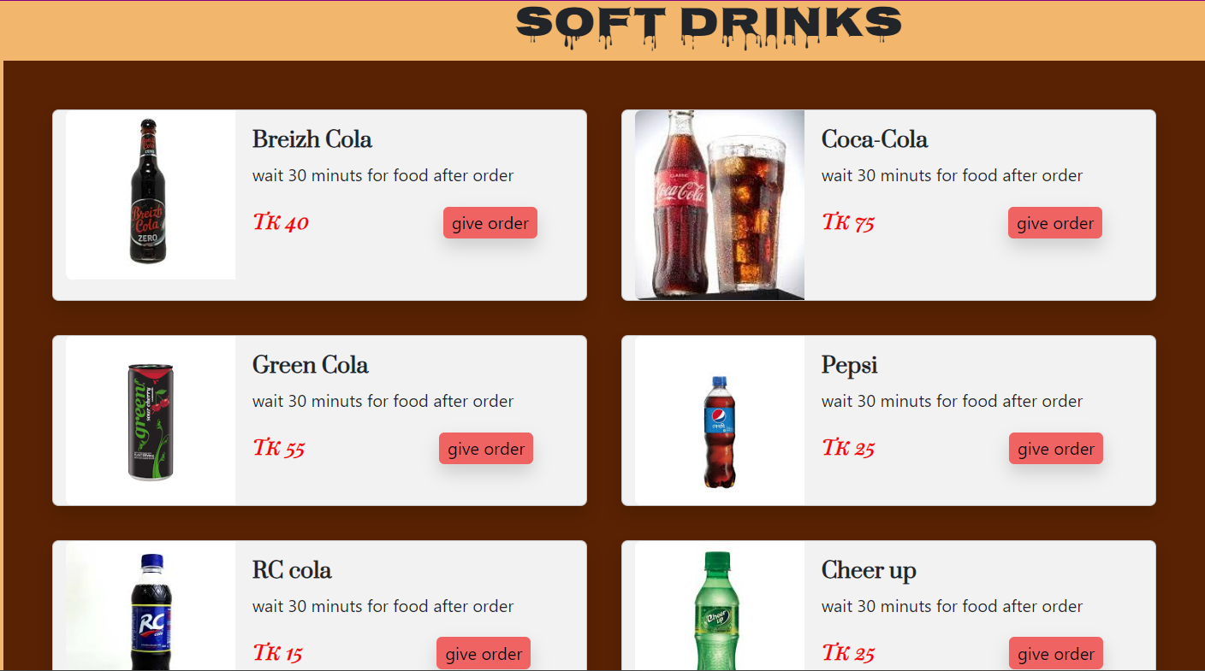
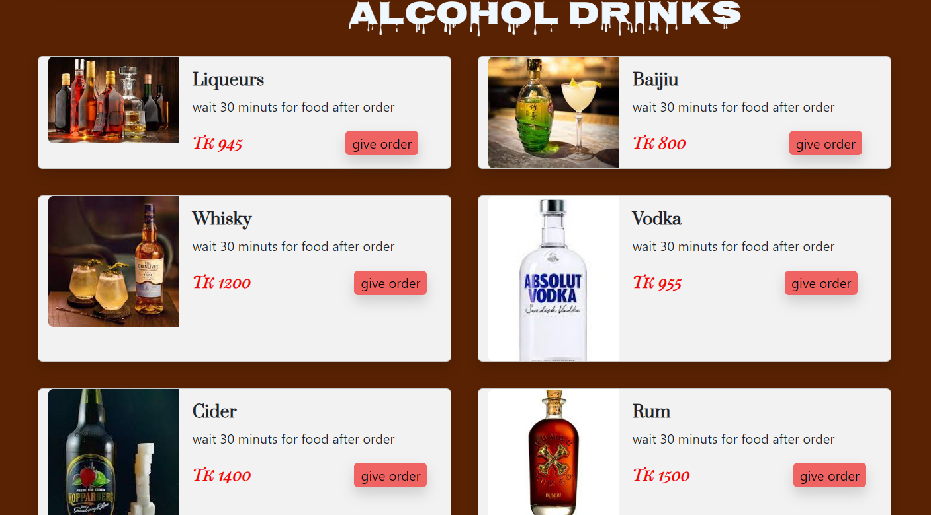
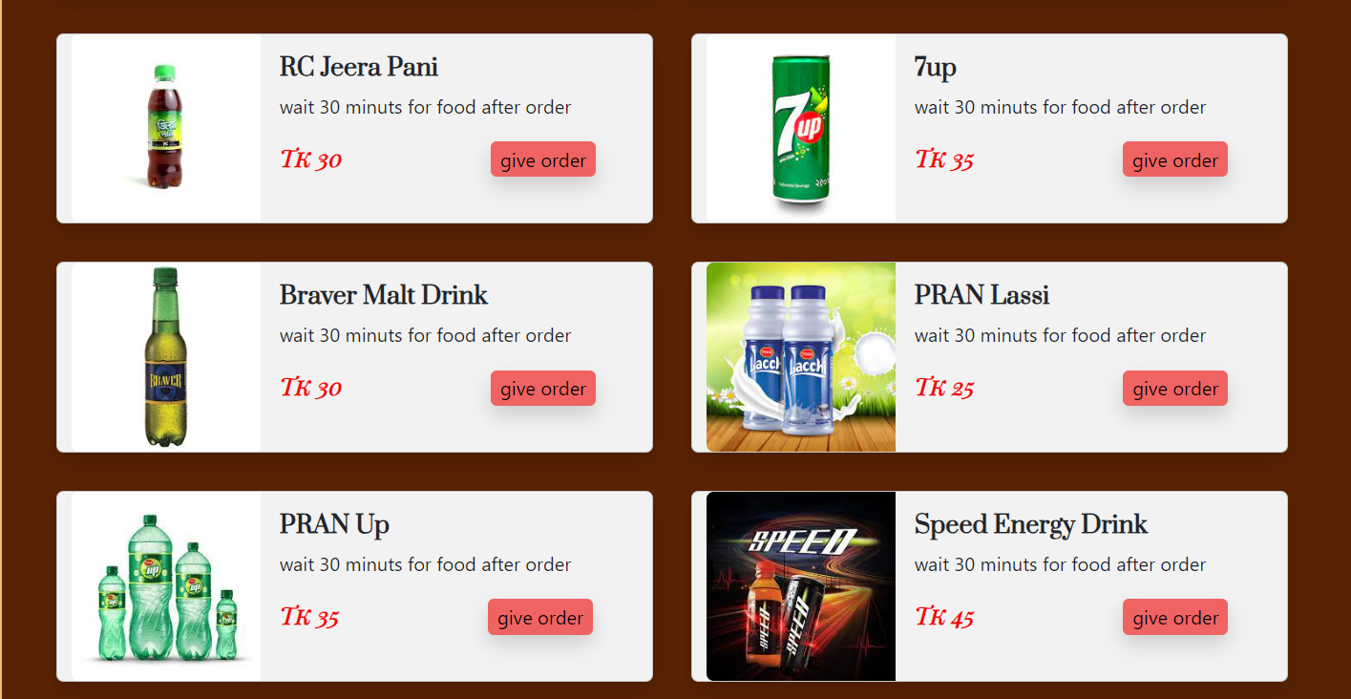
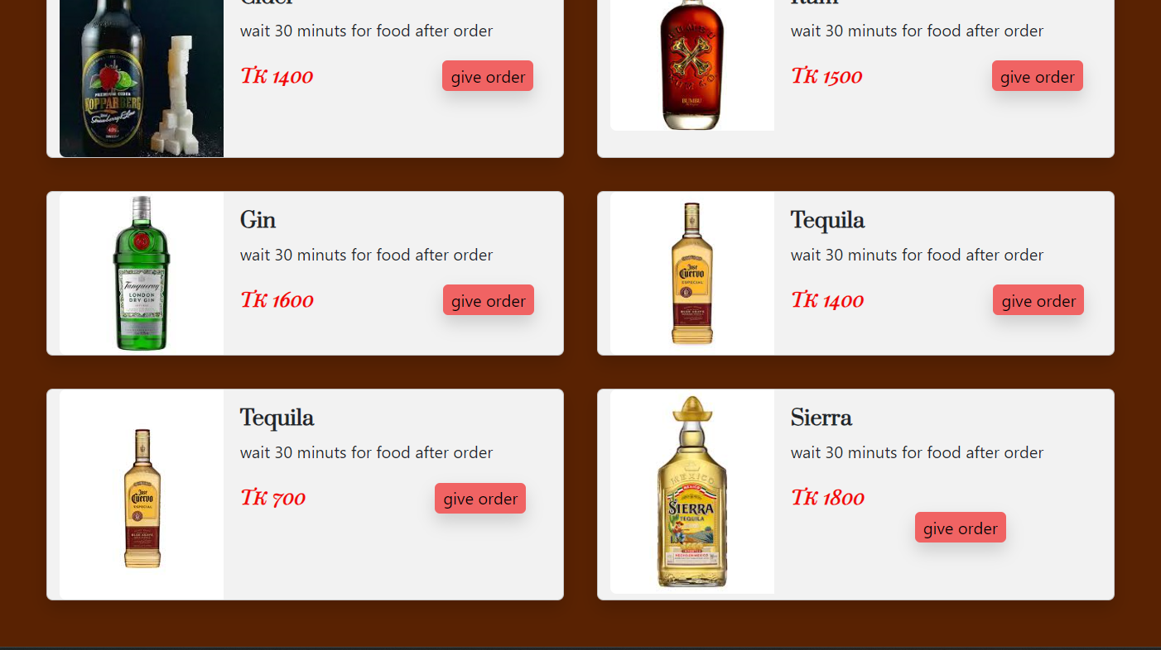
Let’s Explore Drinks Section
DRINKS

Slide 10
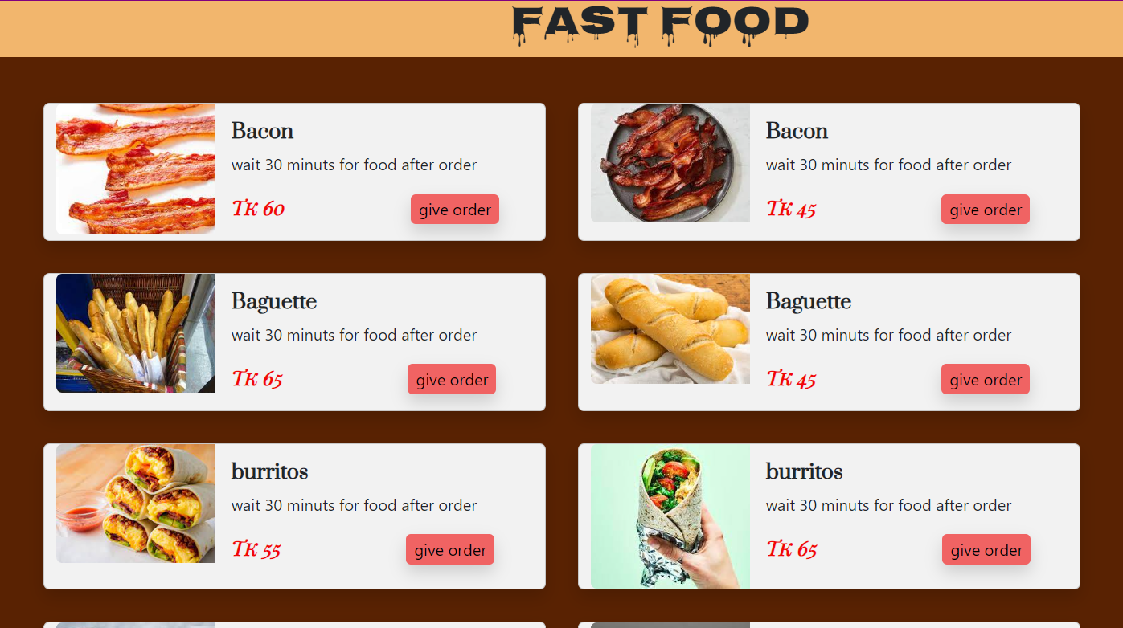

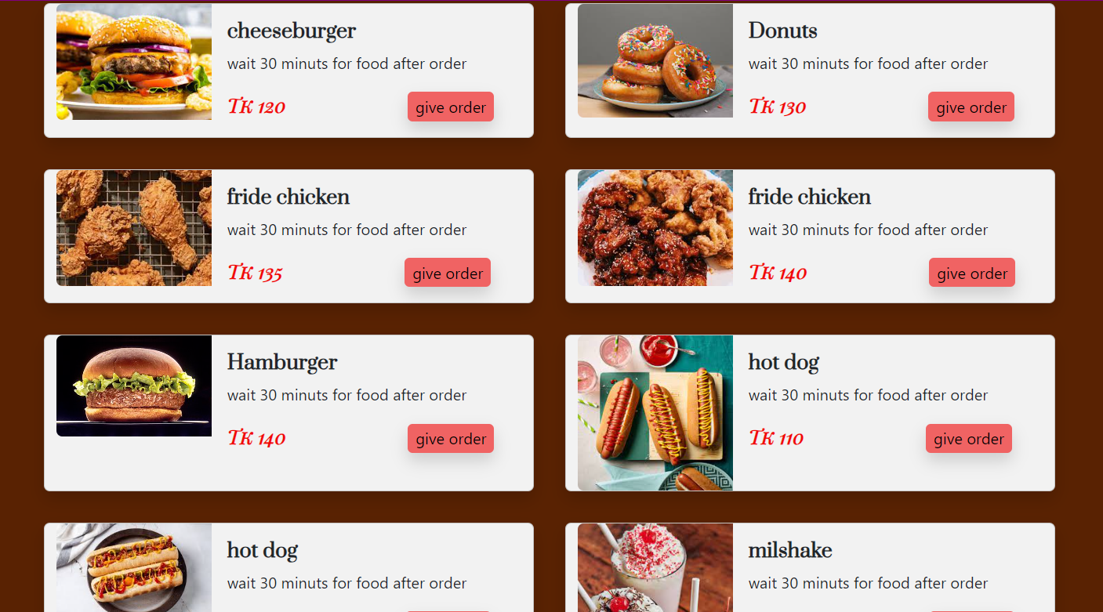
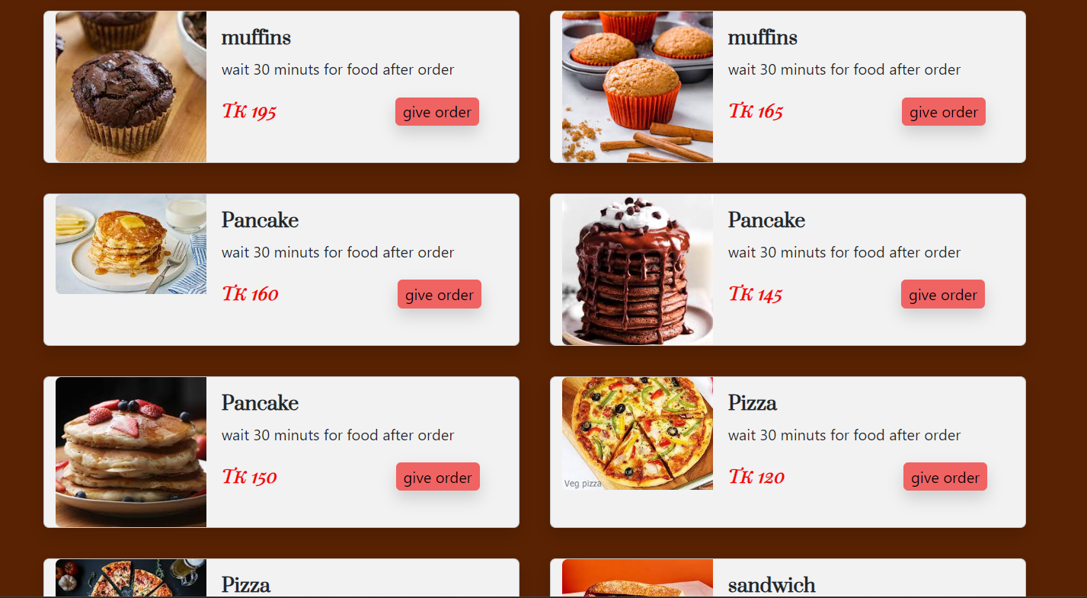
FAST FOOD
One of the best fast food menu
Fast food restaurant means premises where customers order, pay for and collect hot or cold meals and drinks from a counter service whether or not the meals and drinks are to be consumed on or off the premises

Slide 11

Let’s Explore Food Menu
FOOD MENU
Categories from Food Menu
16 ITEM
FISH
16 ITEM
16 ITEM
CHICKEN
KABAB & GRILL
VEGETABLE
SALAD
16 ITEM
16 ITEM
BHORTA
16 ITEM

Slide 12

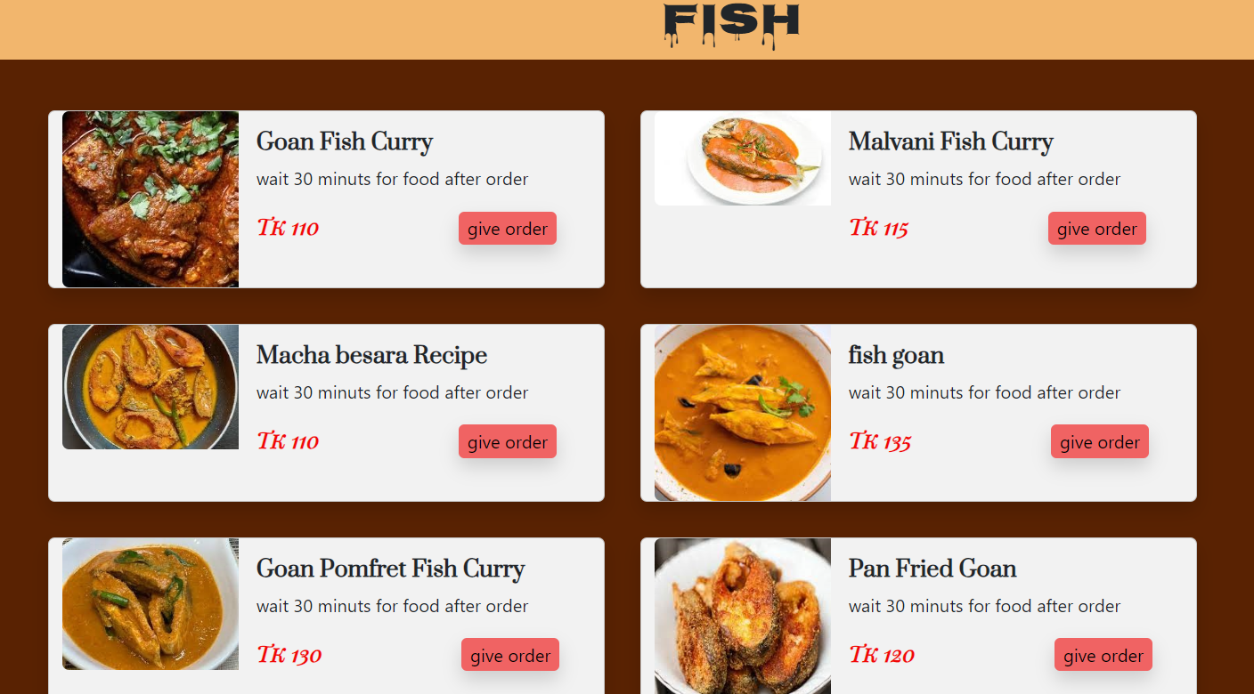
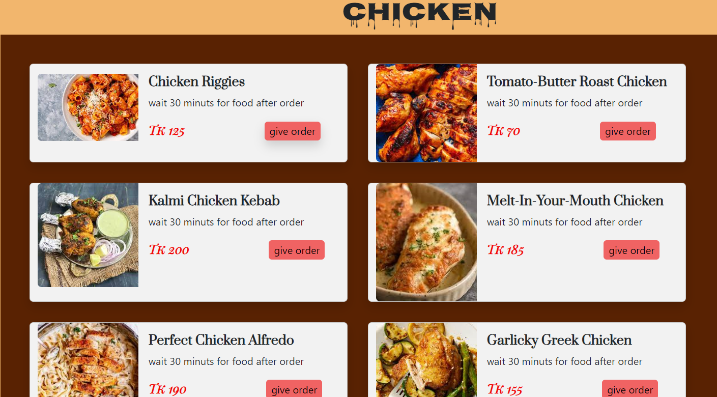
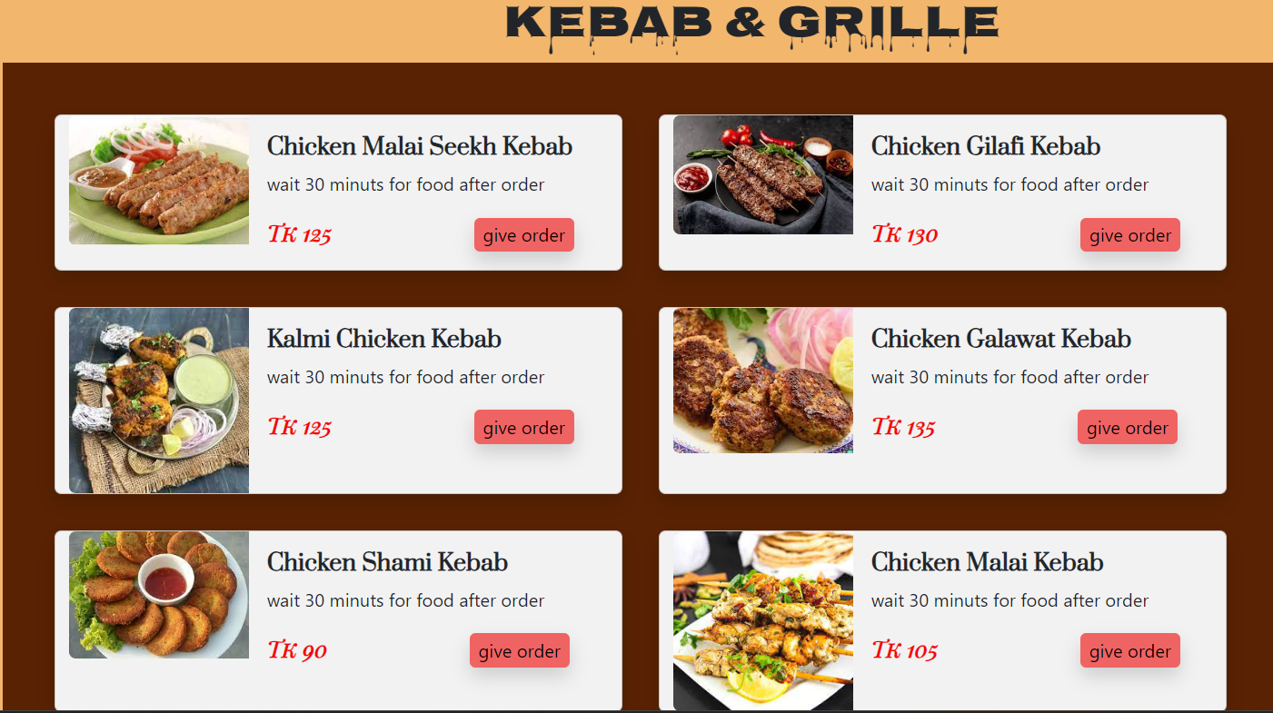
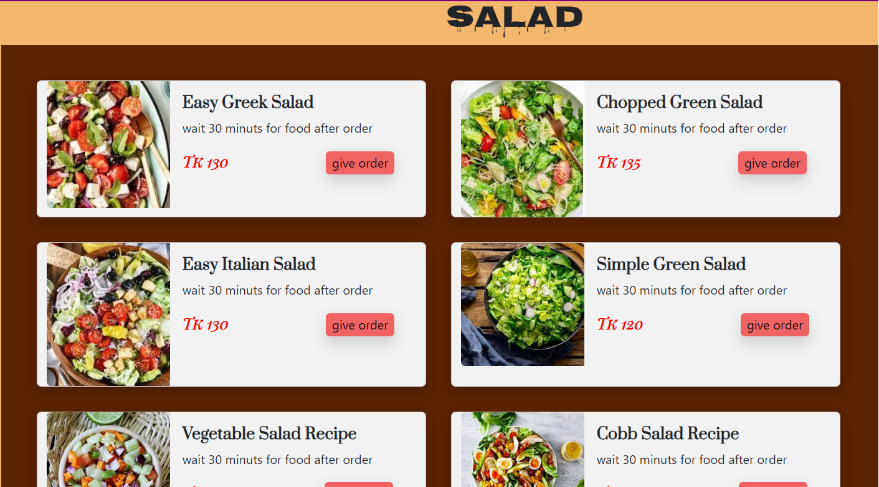
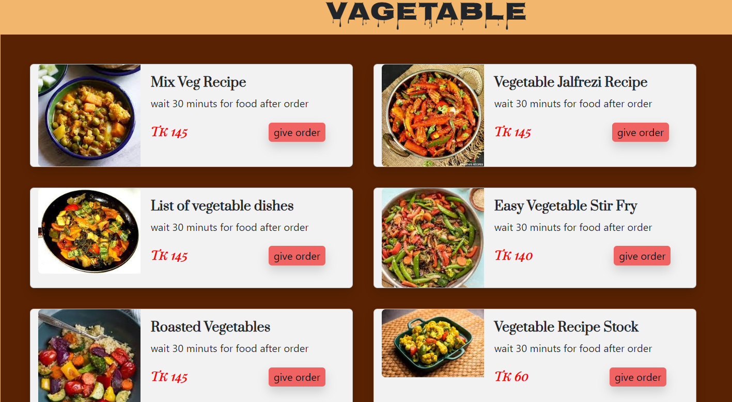
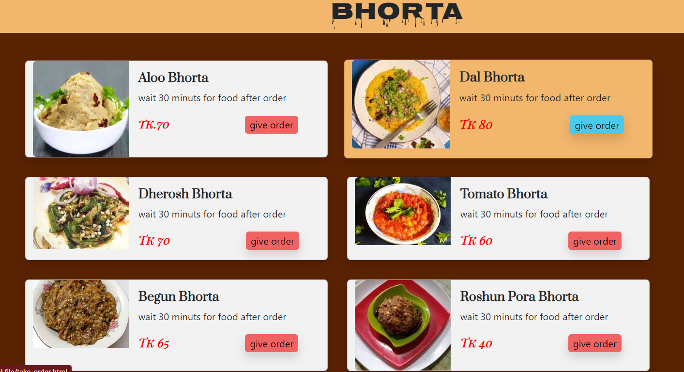
Let’s Explore Food Menu
FOOD MENU
Categories from Food Menu

Slide 13

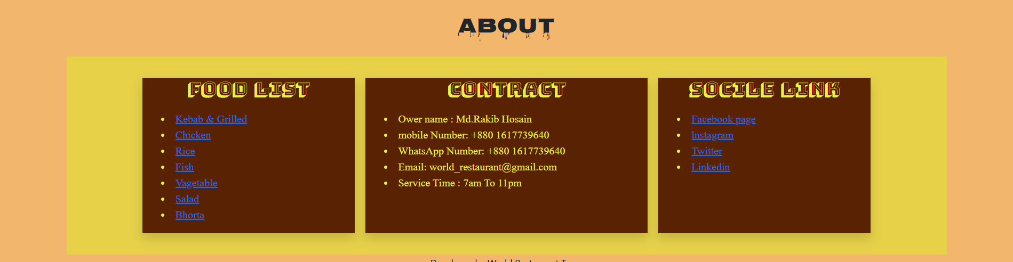
ABOUT
In this About page site users got to learn more about the restaurant. If we want to convert visitors to users, capture opportunities to work with people, and give our regular users a deeper appreciation of what we does, a well written About page is Important.

